Slide 1
Challenge 2 Extension
When the TOUCH sensor touched, Challenge 2 asked you to
Back up a bit (a fixed amount)
Then turn right 90 degrees (a fixed amount)
Modify your challenge 2 to
Backup a variable amount (between 0.5 and 2 rotations)
Then turn left or right a variable amount (say up to 60 degrees)

Slide 2
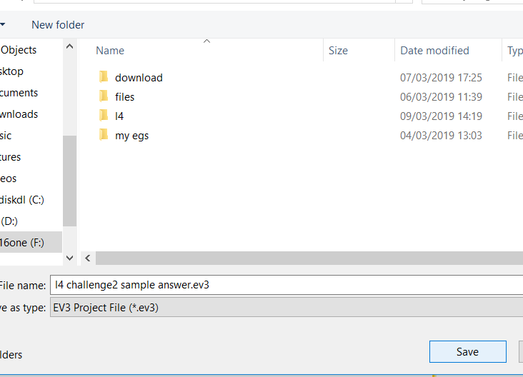
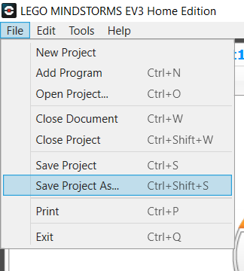
Save your current challenge 2
First step is save your challenge 2 program so that if you make some errors you can always go back to the last working program.
File > save project as..

Slide 3
Extension 2
To back up a variable amount you will need to use the RANDOM block
To turn a variable amount you will also need to use the RANDOM block
To vary the turn from left to right you will need to set the random number from and to values to be –number to number
Instructions for using the RANDOM block are on the next slide

Slide 4
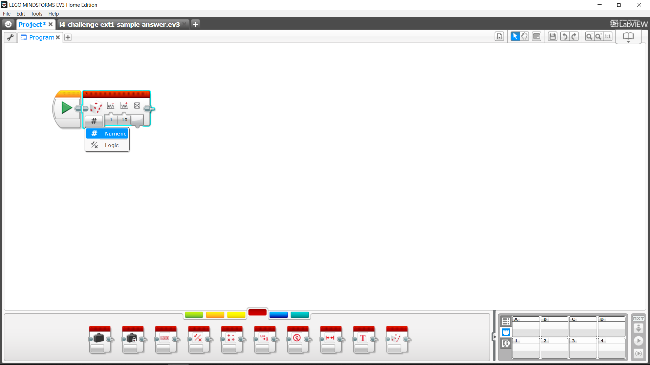
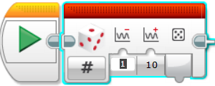

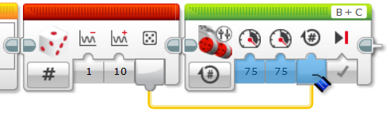
Random numbers – How To
Select Random Block and insert before your desired action
Select “Numeric” on Random
Set a lower and upper value for the required random number
Drag from random number to desired block number

Slide 5
SAVE your EV3 Program
Remember to Save your EV3 program using
File > Save Project As

